Slide 1
Packet Sniffing and Spoofing

Slide 2
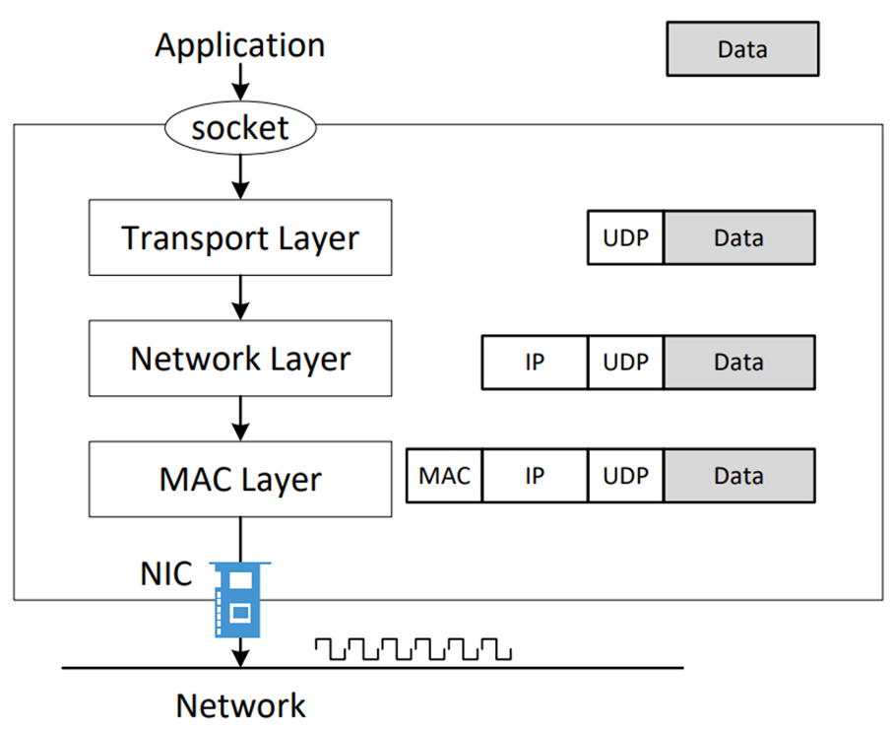
How Packets are Constructed

Slide 3
Socket APIs
Sockets allow communication between two different processes on the same or different machines
Stream Sockets - Delivery in a networked environment is guaranteed
Datagram Sockets - Delivery in a networked environment is not guaranteed
Raw Sockets - Provides users access to the underlying communication protocols. A raw socket receives or sends the raw datagram not including link layer headers

Slide 4
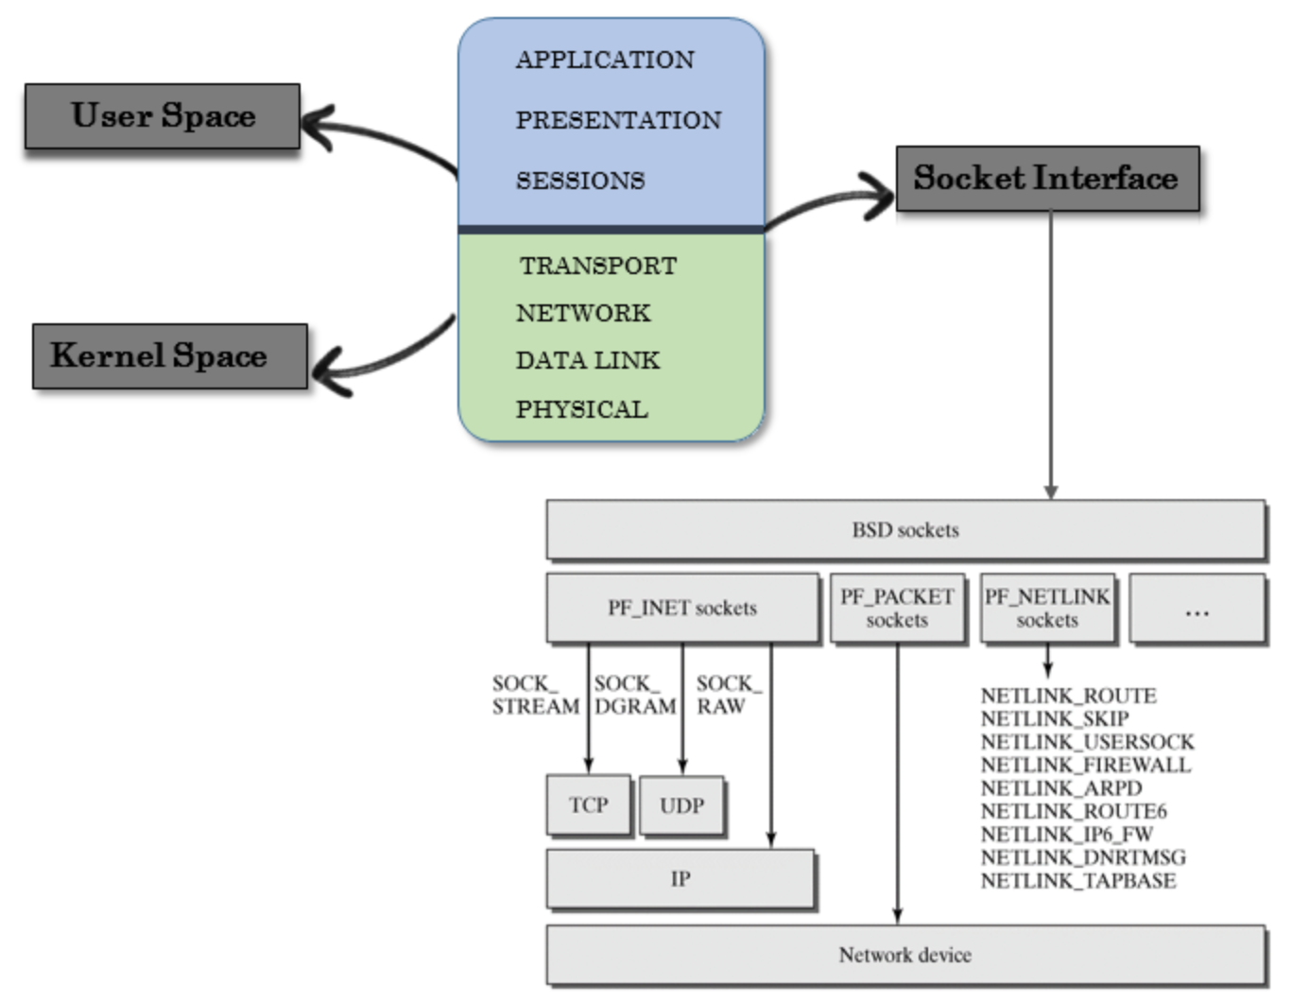
Socket Interface
Source: https://0xbharath.github.io/art-of-packet-crafting-with-scapy/networking/socket_interface/index.html

Slide 5
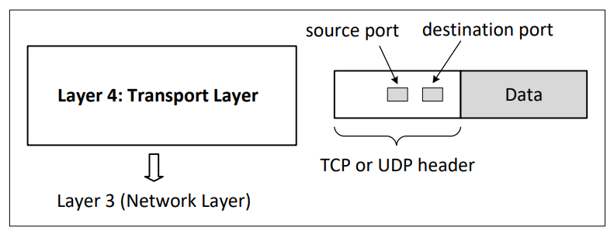
Layer 4: Transport Layer

Slide 6
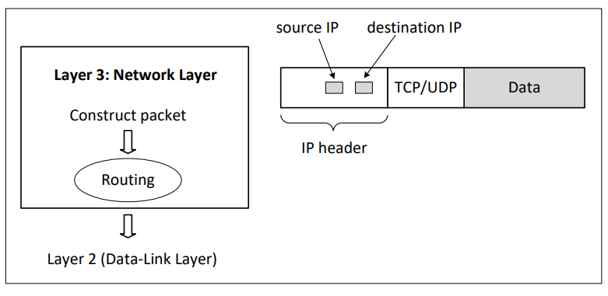
Layer 3: Network Layer

Slide 7
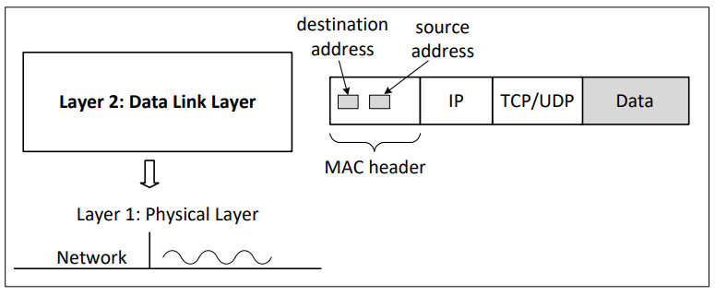
Layer 2: Data Link Layer (MAC Layer)

Slide 8
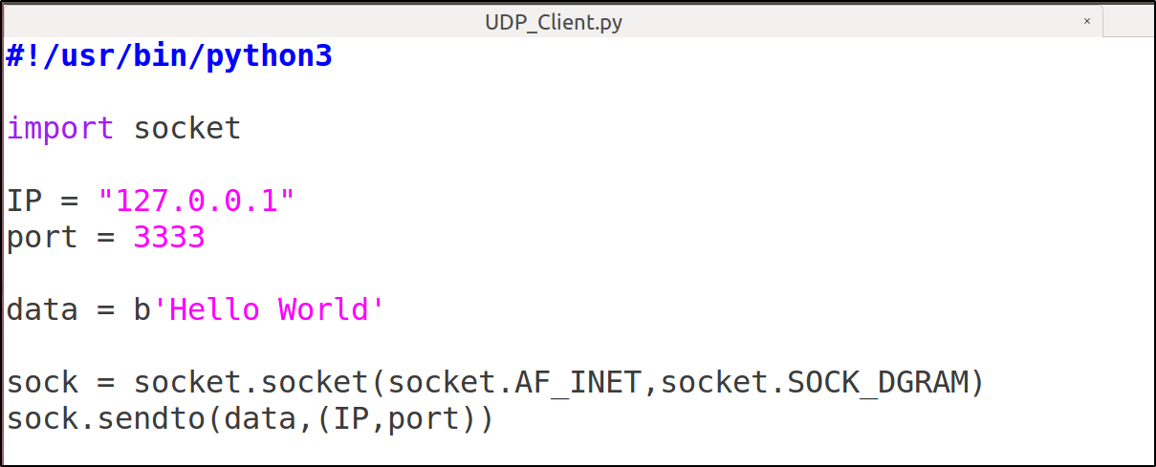
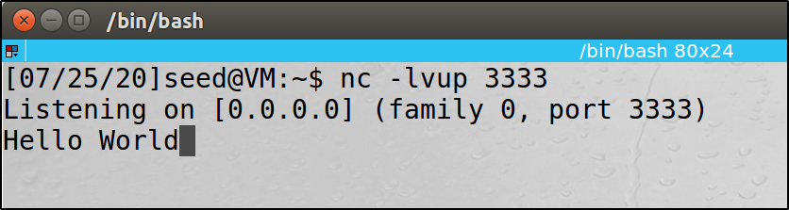
Sending UDP Packet Using Python

Slide 9
Remarks
A pair (host, port) is used for the AF_INET address family, where host is a string representing either a hostname in Internet domain notation like ‘www.ucmo.edu’ or an IPv4 address like ‘1.2.3.4’, and port is an integer
Send data to the socket. Return the number of bytes sent. sendto() sends out individual packet
socket.sendto(bytes, address)
The data sent must be in the binary format. You can use either encode() to convert the message into bytes or directly use the binary string (b’hello world’)
Notes:
Sendto() sends out individual packet

Slide 10
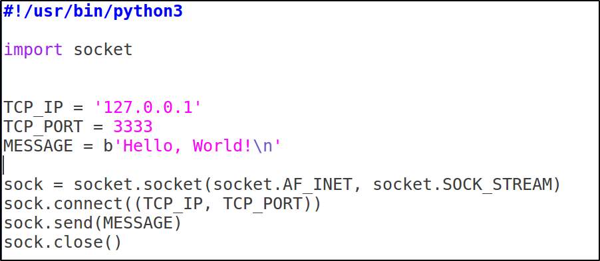
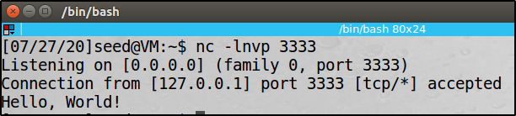
Sending TCP Packet Using Python

Slide 11
Remark
Connect to a remote socket at address. The client and server will complete the TCP three-way handshake to establish the connection
socket.connect(address)
Send data to the socket. Returns the number of bytes sent. The send() method can only be used with a connected socket
socket.send(bytes)
The number of bytes sent by the send() method may be less than the size of the data passed in. Unlike send(), sendall() continues to send data from bytes until either all data has been sent or an error occurs. None is returned on success

Slide 12
Netcat (nc)
The Swiss army knife of TCP/IP connections
Netcat takes Standard Input and sends it across the network
Receives data from the network and puts it on Standard Output
Messages from Netcat itself goes to Standard Error which is displayed on the Standard Output
Std In
Netcat
Send packets
Std Out
Receive Packets
The System
The Network
Std Err

Slide 13
Netcat Usage Continued
Clients initiate connections
# nc -nv [targetIP] [remote_port(s)]
Listeners wait for connections
# nc -lvp [local_port]
Std In
Std In
Netcat (client mode initiates a connection)
Netcat (listen mode waits for a connection)
The Network
Std Out
Std Out

Slide 14
Packet Sending Tools
Using netcat
Bash: /dev/tcp or /dev/udp pseudo device
Others: telnet, ping, etc.

Slide 15
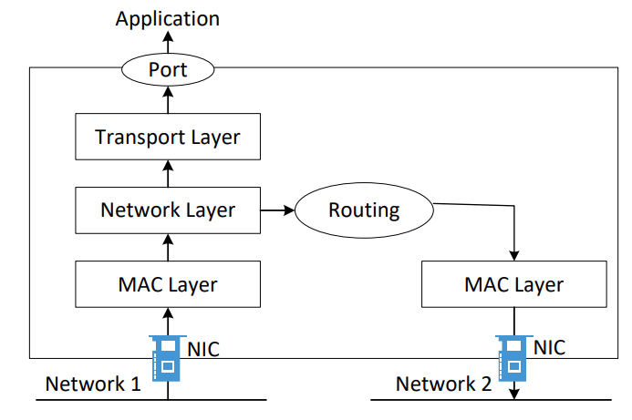
How Packets Are Received

Slide 16
How Packets Are Received
NIC (Network Interface Card) is a physical or logical link between a machine and a network
Each NIC has a MAC address
Every NIC on the network will hear all the frames on the wire
NIC checks the destination address for every packet, if the address matches the cards MAC address, it is further copied into a buffer in the kernel
Notes:
After copying into the kernel buffer, the card interrupts the CPU informing it about the availability of a new packet

Slide 17
Promiscuous Mode
The frames that are not destined to a given NIC are discarded
When operating in promiscuous mode, NIC passes every frame received from the network to the kernel
If a sniffer program is registered with the kernel, it will be able to see all the packets
In Wi-Fi, it is called Monitor Mode
Notes:
It should be noted that elevated or root privileges are required to put a NIC card in promiscuous mode

Slide 18
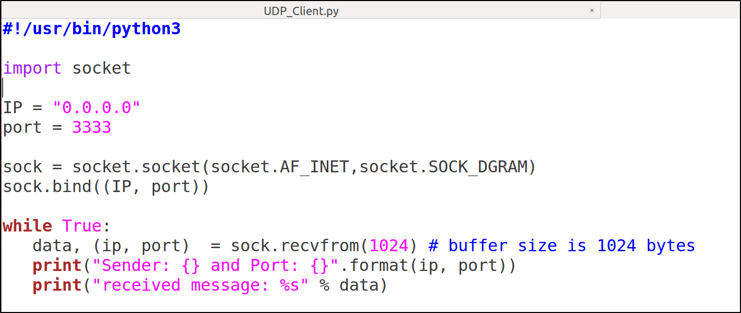
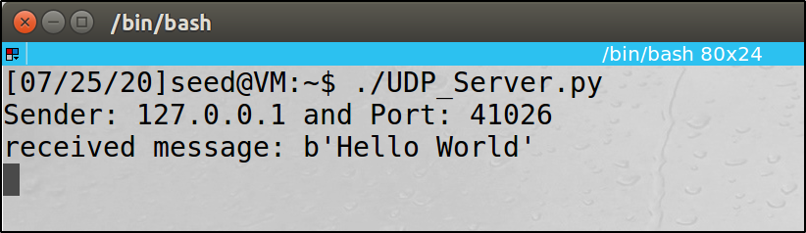
Receiving UDP Packet Using Python

Slide 19
Remark
Bind the socket to address. If you pass an empty string for the hostname or IP address, the server will accept connections on all available IPv4 interfaces (equivalent to ‘0.0.0.0’)
socket.bind(address)
Receive data from the socket. The return value is a pair (bytes, address) where bytes is a bytes object representing the data received and address is the address of the socket sending the data. recvfrom() receives individual packet. The bufsize argument of 1024 used above is the maximum amount of data to be received at once. It doesn’t mean that recvfrom() will return 1024 bytes
socket.recvfrom(bufsize)
Notes:
Recvfrom() receives individual packet

Slide 20
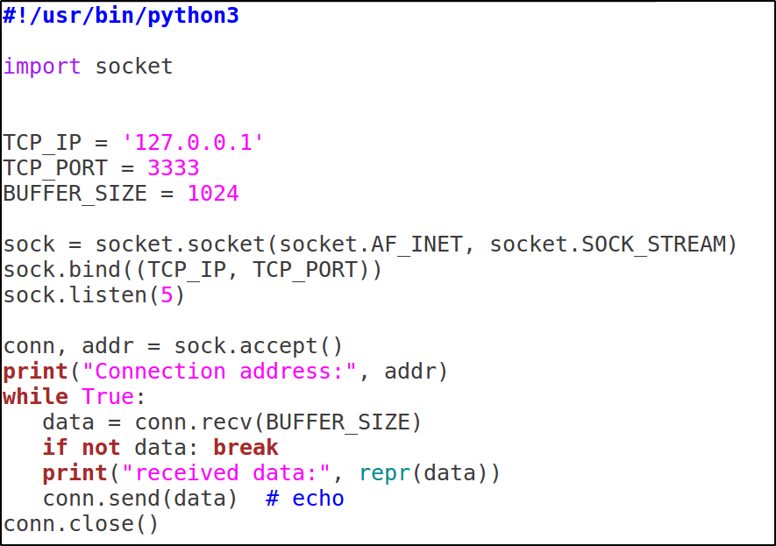
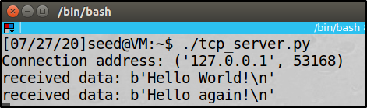
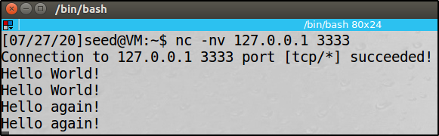
Receiving TCP Packet Using Python

Slide 21
Remark
Enable a server to accept connections. The backlog specifies the number of unaccepted connections that the system will allow before refusing new connections. In Linux, the maximum values can be found via /proc/sys/net/core/somaxconn
socket.listen([backlog])
The accept() method blocks execution and waits for an incoming connection. The return value is a pair (conn, address) where conn is a new socket object usable to send and receive data on the connection, and address is the client address bound to the socket on the other end of the connection
socket.accept()
Receive data from the socket. The return value is a bytes object representing the data received (no client address)
socket.recv(bufsize)
Notes:
If conn.recv() returns an empty bytes object, b'', that signals that the client closed the connection and the loop is terminated

Slide 22
Blocking Calls
A socket function or method that temporarily suspends your application is a blocking call
accept(), connect(), send(), and recv() block, meaning they don’t return immediately
Blocking calls have to wait on system calls (I/O) to complete before they can return a value
The caller, are blocked until they’re done or a timeout or other error occurs

Slide 23
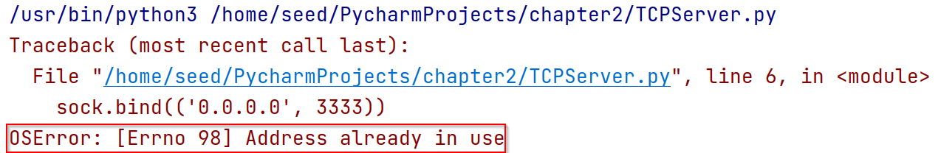
Remark
Running the TCP sever several times with too small delay between executions, could lead to this error
This is because the previous execution has left the socket in a TIME_WAIT state, and can’t be immediately reused
There is a socket flag to set, in order to prevent this, socket.SO_REUSEADDR
The SO_REUSEADDR flag tells the kernel to reuse a local socket in TIME_WAIT state, without waiting for its natural timeout to expire

Slide 24
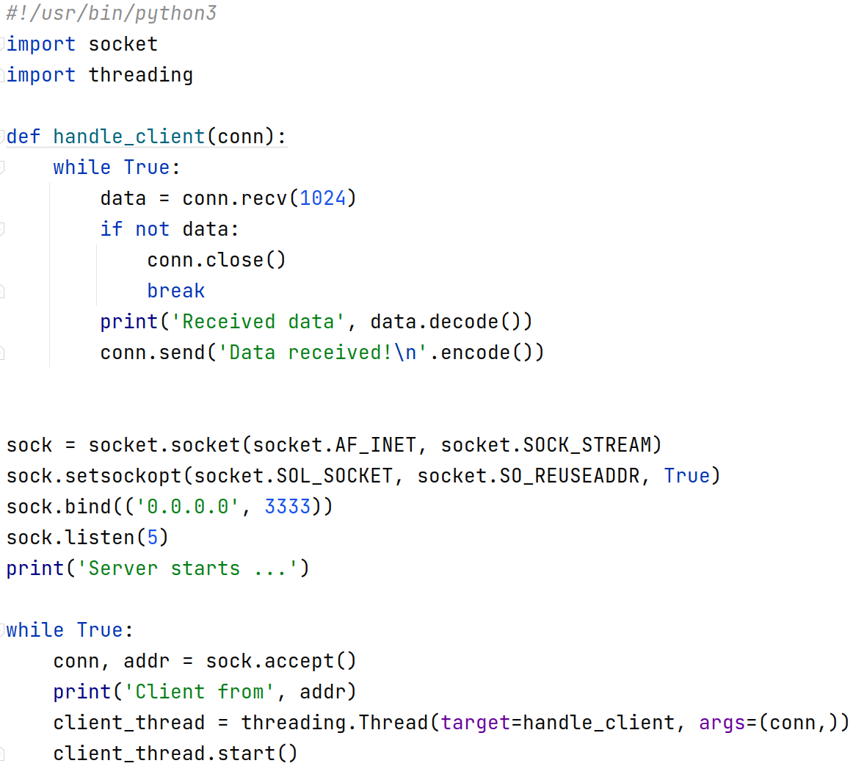
Multi Threading TCP Server

Slide 25
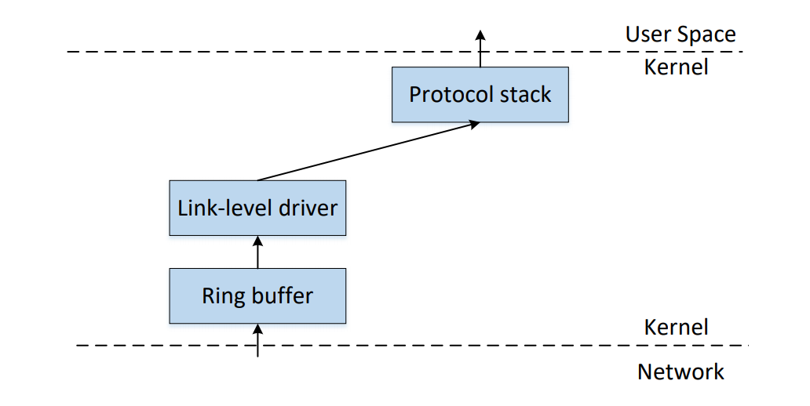
Packet Sniffing
Packet sniffing describes the process of capturing live data as they flow across a network
How to get a copy of a packet? – use raw socket

Slide 26
Packet Sockets
Packet sockets are used to receive or send raw packets at the link layer
packet_socket = socket(AF_PACKET, int socket_type, int protocol);
socket_type: SOCK_RAW for raw packets including the link-level header
When protocol is set to htons(ETH_P_ALL), then all protocols are received
All incoming packets of that protocol type will be passed to the packet socket before they are passed to the protocols stack implemented in the kernel

Slide 27
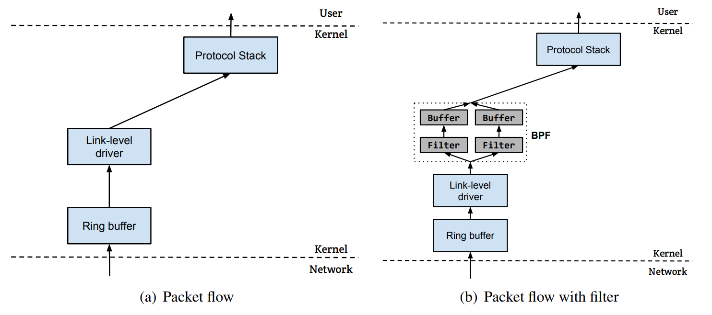
Packet Flow With/Without Filters

Slide 28
Pcap API
The Packet Capture library provides a high level interface to packet capture systems
Linux: libpcap
Windows: WinPcap
Adopted by many tools
Wireshark, tcpdump, snort, nmap, Scapy, etc.

Slide 29
Useful Packet Filters
Protocol primitive
ether, ip, ip6, arp, tcp, udp, icmp
Type primitive
host [host]: only give me packets to or from that host
net [network]: give me packets for that given network
port [port_number]: only packets for that port
portrange [start – end]: only packets in that range of ports
Direction primitive
src, dst
Use “and” or “or” to combine
Use “not” to negate

Slide 30
Examples
Show all TCP port 443 packets going to or from host 192.168.1.81
tcp and port 443 and host 192.168.1.81
Show all UDP packets from 192.168.1.81
udp and src host 192.168.1.81
Show all packets to or from 192.168.1.0/24 subnet and not display ARP packets
net 192.168.1.0/24 and not arp

Slide 31
Packet Sniffing Tools
Tcpdump
Command line
Good choice for containers (in the lab setup)
Wireshark
GUI
Good choices for the environment supporting GUI (not containers)
Scapy
Implement your own sniffing tools

Slide 32
Tcpdump Examples
tcpdump -n -i eth0
-n: do not resolve the IP address to host name
-i: sniffing on this interface
tcpdump -n -i eth0 -vvv “tcp port 179”
-vvv: asks the program to produce more verbose output.
tcpdump -i eth0 -w /tmp/packets.pcap
saves the captured packets to a PCAP file
use Wireshark to display them

Slide 33
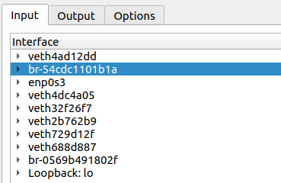
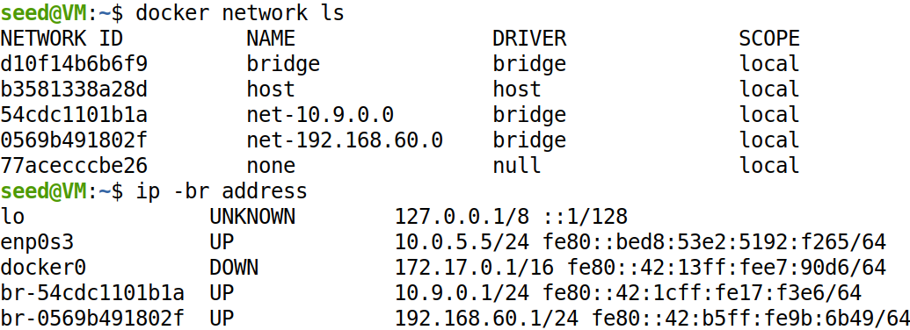
Wireshark and Containers
Find the correct interface

Slide 34
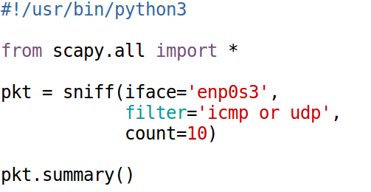
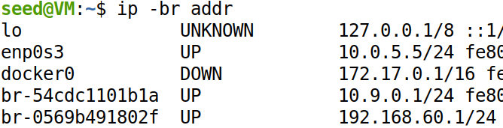

Packet Sniffing Using Scapy (1)

Slide 35
Scapy’s sniff Function
Scapy’s in-built sniff() function helps us capture all traffic. It sniffs packets and return a list of packets
sniff() has count, filter, iface, lfilter, prn, timeout options
Argument prn that allows you to pass a function that executes with each packet sniffed
Can capture packets with link layer and above
Scapy sniffer is not designed to be super fast so it can miss packets sometimes

Slide 36
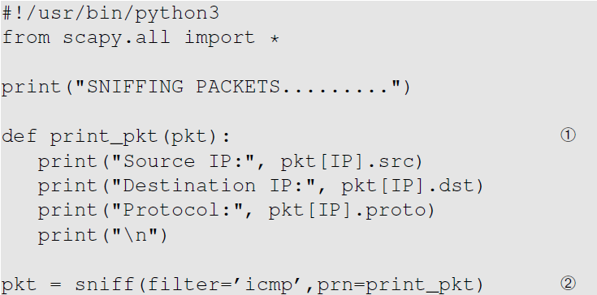
Packet Sniffing Using Scapy (2)

Slide 37
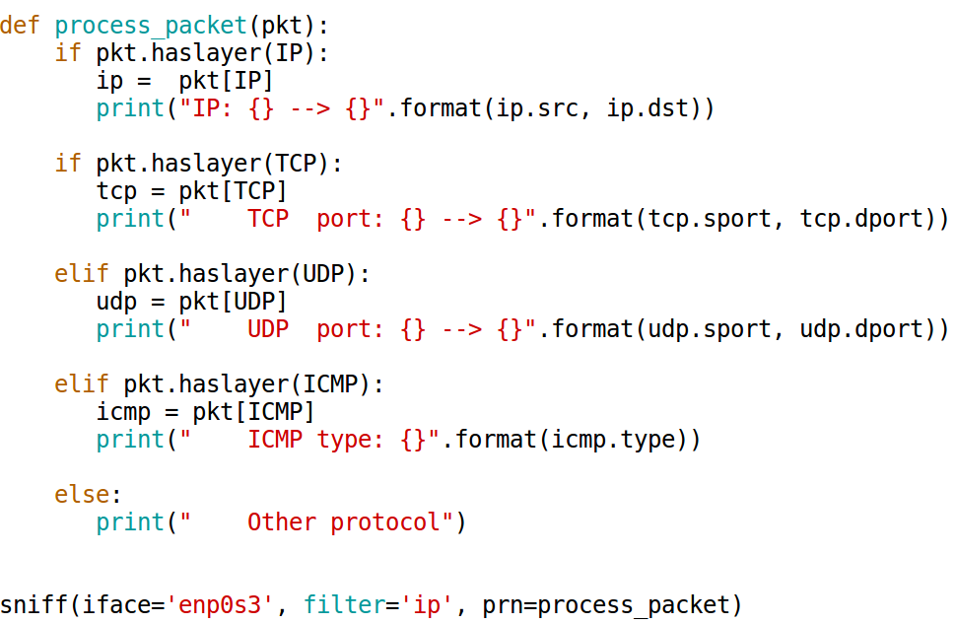
A Sniffer Example

Slide 38
Packet Spoofing
In normal packet construction
Only some selected header fields can be set by users
OS set the other fields
Packet spoofing
Set arbitrary header fields
Using tools
Using Scapy

Slide 39
Packet Spoofing
When some critical information in the packet is forged, we refer to it as packet spoofing
Many network attacks rely on packet spoofing
Let’s see how to send packets with spoofing

Slide 40
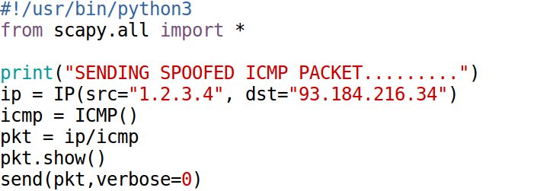
Spoofing ICMP Packets
Notes:
Explain the layer stacking in Scapy: ip/icmp

Slide 41
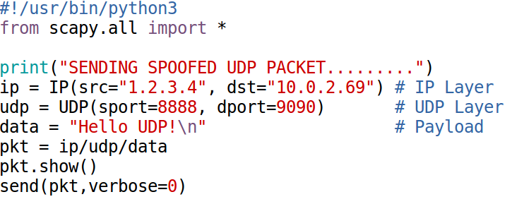
Spoofing UDP Packets

Slide 42
Sniffing and Then Spoofing
In many situations, we need to capture packets first, and then spoof a response based on the captured packets.
Procedure (using UDP as example)
Use PCAP API to capture the packets of interests
Make a copy from the captured packet
Replace the UDP data field with a new message and swap the source and destination fields
Send out the spoofed reply

Slide 43
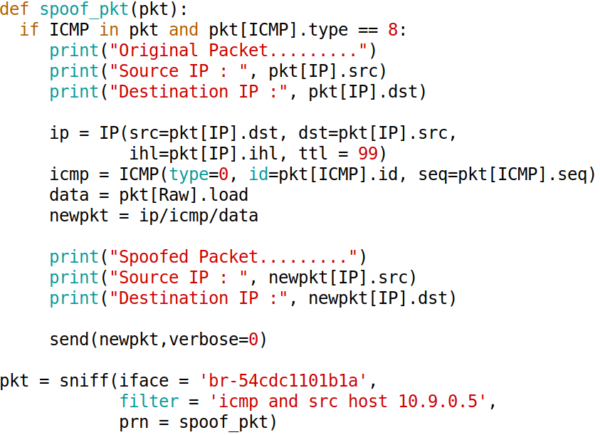
Sniff Request and Spoof Reply: Code

Slide 44
Packet Spoofing: Scapy v.s C
Python + Scapy
Pros: constructing packets is very simple
Cons: much slower than C code
C Program (using raw socket)
Pros: much faster
Cons: constructing packets is complicated
Hybrid Approach
Using Scapy to construct packets
Using C to slightly modify packets and then send packets

Slide 45
Summary
Packet sniffing
Using raw socket
Using PCAP APIs
Packet spoofing using raw socket
Sniffing and the spoofing

